Slide 1

.
.
A CASE STUDY
BY: ISHWOR KHATIWADA

Slide 2
02 –ALIBABA GROUP
05 - ALIPAY
06 –SUCCESS
FACTORS
02 – HISTORY & BACKGROUND
Table of Contents
03 – alibaba.com
07 – REVINUE/
compEtitor
.
04 -Taobao.com
08 – Challenges
Conclusion
Notes:
© Copyright Showeet.com

Slide 3
Alibaba Group
Alibaba Group Holding Limited (also known as Alibaba Group is a Chinese multinational specializing in e-commerce, retail, Internet, and technology.
The company provides consumer-to consumer/C2C) ,business-to-consumer (B2C/online retailers), and business-to-business (B2B/ Between companies).
services via web portals, as well as electronic payment services , shopping search engines and cloud computing services.

Slide 4
Background and History
Alibaba.com, a member of the Alibaba Group of companies.( Alibaba, Taobao, Ali-express, Alipay)
The company was founded in 1999 by 18 people led by jack ma.
The English language website www.alibaba.com specializes in B2B trades especially for international buyers trying to connect to Chinese sellers.
SERVICES:
E-commerce, Cloud computing, Entertainment
Mobile commerce ,Retail ,Mobile media ,Films , TV shows.
Alibaba has data centres in china and hong-kong that runs a cloud platform called “apsara”

Slide 5
Companies Under Alibaba
Logistics
Cloud Computing
Finance
Digital
Entertainment
Chinese Retail Marketplaces
Wholesale Commerce
Ant Financial
(includes Alipay)
MY bank
Taobao Marketplace
Tmall
Rural Taobao
1688.com (China)
Alibaba.com (global)
Cainiao Network
Alibaba Cloud
Alibaba Pictures
Alibaba Music
Alibaba Sports
UC browser

Slide 6
Alibaba
Alibaba(1999 ) is the largest retailing and ecommerce company of China and is listed in fourth positions in the world .
It is a B to B platform – Business to Business
It shares out it’s product on especially the business man of other countries like India, Pakistan, Thailand and many more
For the use of Chinese , it has it’s own domestic site called 1688.com as alibaba.com is global
In recent year Alibaba’s revenue from it’s core commerce was $56.2 billion.
It’s sales and profit is more than that of amazon and eBay.
it’s called ‘Amazon of China’.

Slide 7

Taobao
It was started in 2003 whose name in Chinese means “to find treasure’ and is a B to B and B to C platform.
It is the online business where anyone can but and sell products.
It contains more than 1 billion products listed.
It also furthermore has extended it’s services into three parts-
Taobao, Tmall and etao.
Etao is search engine and comparision website.
In tmall, the Chinese as well as other international companies sell mostly the branded goods(

Slide 8

AliPay
60%
Third-party mobile and online payment platform
The service was first launched in 2003
Operates with more than 65 financials Visa and MasterCard
Provides multiple security
QR-code
payment

Slide 9
WHY SUCCESSFUL ?
It’s a Platform to support small and medium sized enterprises (SMEs).
Alibaba.com also offers its members and other SMEs import/export supply chain services, including customs clearance, trade financing and logistics services.
The key benefits of using alibaba.com are such as Low cost, Access to many suppliers/buyers, Quick transaction time, More transparency in transaction, Lower risk of fraud.
facilitate business-to-business sales, business-to-consumer sales and consumer-to-consumer sales .
Operates in 200+ countries,1,50,000brands(18000 international brands).

Slide 10
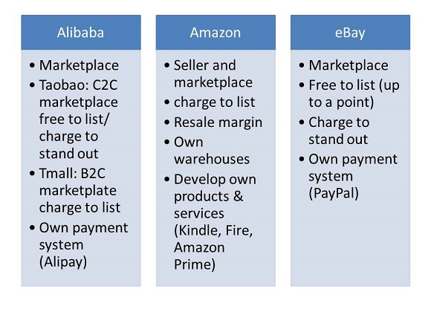
Competitors

Slide 11
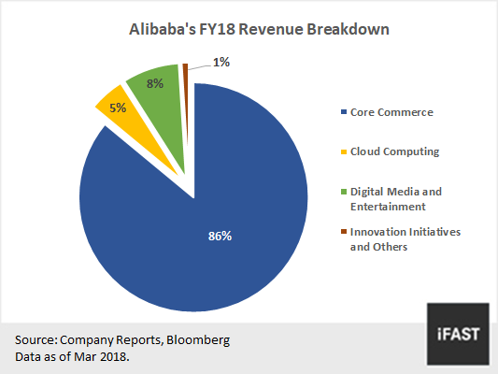

Slide 13
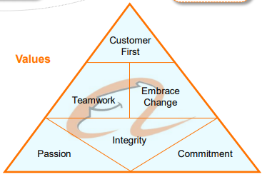
CONCLUSION AND VISION
Alibaba.com has grown admirably from its initial beginnings as a small E-Marketplace into a giant e-Marketplace.
The four Ps(product, price, place, and promotion) of the marketing strategies have contributed to the success of Alibaba.com.

Slide 14
References
en.wikipedia.org/wiki/Alibaba_Group
https://www.alibaba.com/
www.bbc.co.uk/news/topics/alibaba
https://www.ukessays.com/essays/marketing/the-alibaba-group-company-analysis-marketing-essay.php
https://www.marketing91.com/marketing-strategy-alibaba/

Slide 15

THANK YOU

